Slide 1
CS401
Modern Programming
Practices

Slide 2
Course Goals
Understand the principles of Object-Oriented
Programming.
Learn how to design an application that supports change
and reuse.
Design and implement an application that integrates all
the learned techniques.
Grow in knowledge and awareness and gain a deeper
understanding of the relationship between SCI and OOP.

Slide 3


Success in software development
Knowledge and
Communication skills
Intelligence
Creativity
Efficiency
Abstraction skills
Management skills
Leadership skills
Well Organized
Just Knowledge

Slide 4
Lesson 1
Overview of Object-Oriented Programming
What is OOP?
Why OOP?
  Abstraction
  Hierarchy of Abstractions
  Reuse
  Change
Present and future of Object-Orientation.

Slide 5
What is OOP?
See the real world as objects and implement these objects
as software objects.
Objects communicating with each other by sending and
receiving messages.
This is how the real world works!

Slide 6
Procedural Programming vs. OOP (1/2)
Procedural Programming:
design solutions to a specific problem
  functional decomposition
  step-wise refinement
Object-Oriented Programming:
build models of systems which solve many problems
Order Entry system
OpenCustomerFile( )
ConstructOrder( )
ShipOrder( )
Order Entry system
Customer
Order
Shipment
functions
Data
Data +
Operations
Data +
Operations
Data +
Operations

Slide 7
Characteristics of OOP
Everything is an object.
Objects are encapsulated (show my picture of a class/object) which supports information hiding.
Objects are self-contained entities which supports reuse of objects.
Objects can inherit behavior from other objects (inheritance) which supports reuse of code.
Objects are independent individual components which supports incremental development.
Objects can take different forms (types) during execution (polymorphism) which supports change.

Slide 8
OO - the big picture
The different techniques in every phase is always in terms of the real world objects.
Analysis
OOA
Design
OOD
Implementation
OOP
Testing
MPP
Deployment

Slide 9
Why OOP? (after 25 years)
OOP helps us manage the biggest problem in software development
Distribution of software
Projects fail
Change
Projects go over
their budget
Complexity of the problem domain
Complexity
Systems are
hard to maintain
Working in teams
Systems are
buggy

Slide 10
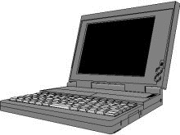

How do humans solve complexity?
Miller (Psychological Review, vol 63(2)) "The Magical Number Seven, Plus or Minus Two: Some Limits on Our Capacity for Processing Information"
What if you have more than 7 things to juggle in your head simultaneously?
Abstraction: abstract details away
Hierarchy: classify and order abstractions

Slide 11
How is complexity handled in software development?
The same way we always have:
Abstraction and Hierarchy
and
Reuse
Support for change
Object-Oriented programming offers support for
Abstraction in the form of Objects
Hierarchy in the form of a Model (of objects)
Reuse in the form of inheritance and in the form of reuse of objects among programmers and projects.
Change in the form of polymorphism.

Slide 12
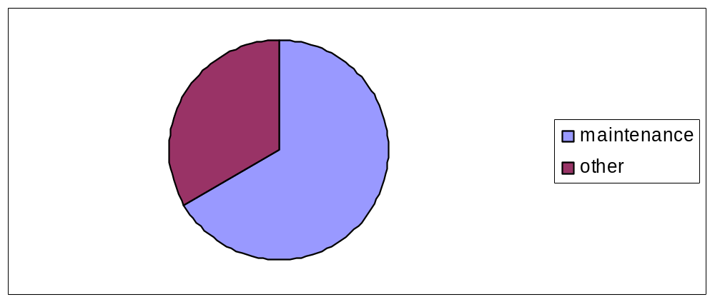
Software costs
2/3 of total software costs is devoted to maintenance
Errors
Change
To reduce errors, objects should be self contained entities.
To manage change, the object model should support change

Slide 13
Support for change
Separate User Interface (UI) from the Business Logic and the
Database.
Presentation Layer
UI
Business Logic
Layer
Persistence Layer
DB
Open Closed principle: The design should be open for extension,
but closed for change.
Program to interface, rather than implementation.

Slide 14
Conclusion
OOP is a new paradigm, and requires a new way of thinking about the process of decomposing problems.
In OOP we create a model of objects that send messages to each other.
OOP is a great tool that helps us manage the complexity of software development.
OOP supports
  Abstraction
  Hierarchy
  Reuse
  Change

Slide 15
UML
Unified Modeling Language
UML enables us to create blueprints(diagrams) of the different
aspects of the software development process.
Unifies popular modeling methods of the early ‘1990s:
  Booch (Grady Booch)
  OMT (James Rumbaugh)
  Objectory (Ivar Jacobson)
Industry wide acceptance
Consist of a number of diagrams
We focus on the class, sequence and object diagrams.

Slide 16
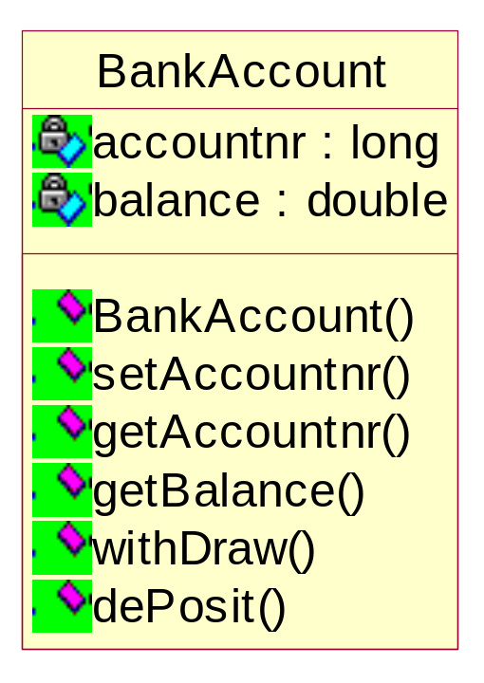
public class BankAccount{
private long accountnr;
private double balance;
public BankAccount(){
balance=0;
}
public void setAccountnr(long acnr){
accountnr=acnr;
}
public long getAccountnr(){
return accountnr;
}
public double getBalance(){
return balance;
}
public void withDraw (double amount){
balance=balance-amount;
}
public void dePosit (double amount){
balance=balance+amount;
}
}
private
classname
attributes
methods
public

Slide 17
Classes simulate real world object relationships with other classes.
A class diagram consists of classes and their relationship to each other.
Different kind of relationships:
Association
Aggregation
Composition
Inheritance

Slide 18
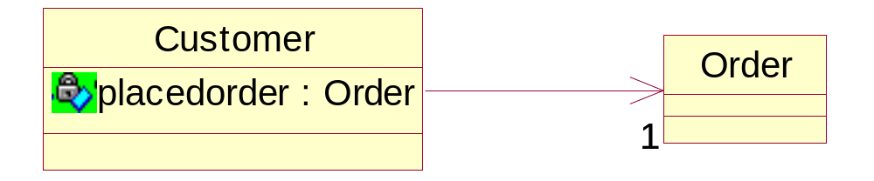
Association
Uni-directional
public class Customer{
private Order placedorder;
}
//Draw the picture of what
//this looks like in RAM.
public class Order{
}

Slide 19
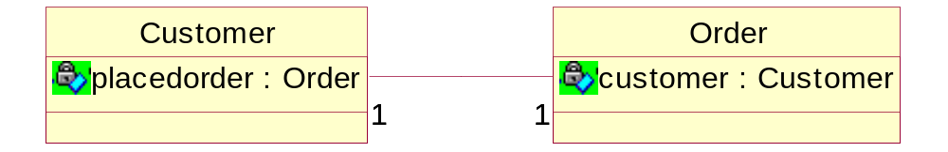
Association
Bi-directional
public class Customer{
private Order placedorder;
}
public class Order{
private Customer customer;
}

Slide 20
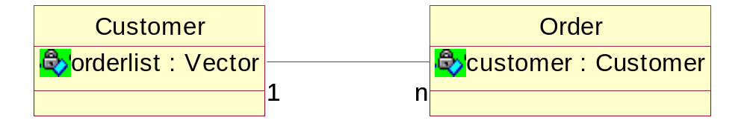
Association
Multiplicity
1 one
3 three
n many
0..n zero or more
1..n one or more
0..1 zero or one
public class Customer{
private ArrayList orderlist;
}
public class Order{
private Customer customer;
}

Slide 21
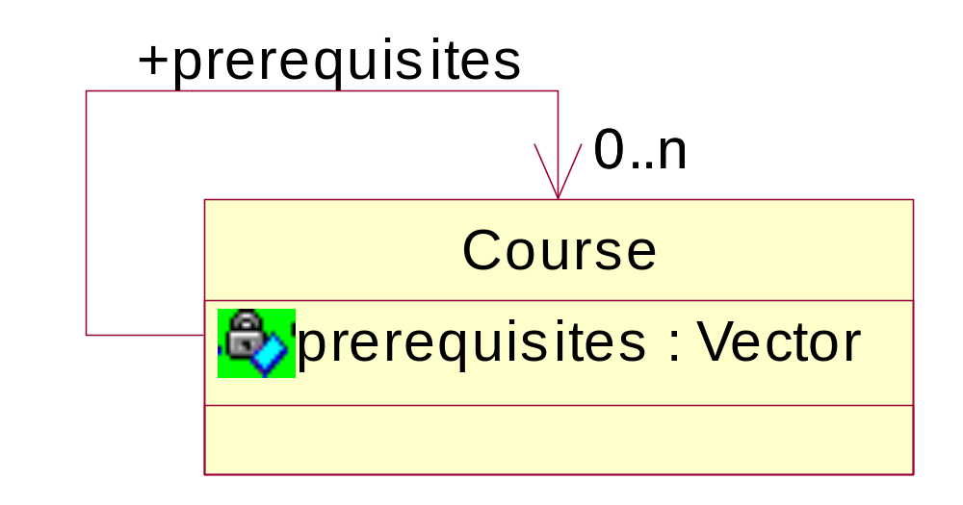
Reflexive Association
Association role
import java.util.ArrayList;
class Course
{
public Course() {}
// The unbounded multiple association is stored in an ArrayList
private ArrayList prerequisites;
}

Slide 22
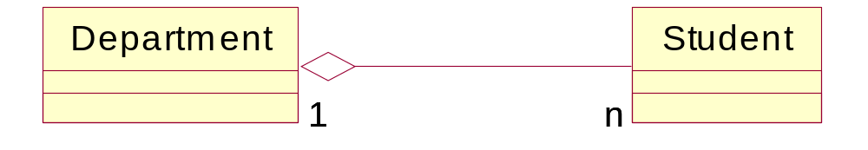
Aggregation/ Composition
Special kind of association
Represents a ‘whole-part’ relationship
‘consists of’
‘contains’
‘is part of’
Code looks the same
as in association.
Also called ‘weak aggregation’
I can delete a department, while students can still exist.
Like association, with the difference that the part cannot
contain the whole (a-cyclic graph)

Slide 23
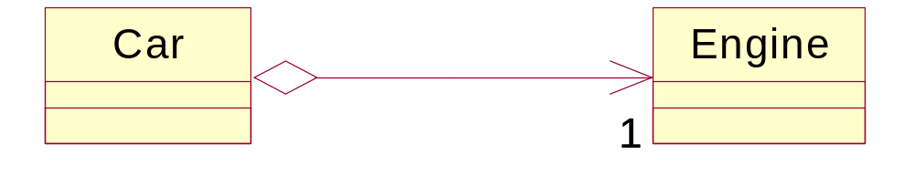
Aggregation/ Composition
strong type of aggregation
The life of the parts is determined by that of the whole.
If the whole is destroyed, so is the part.
The part cannot belong to more than one whole.
(Note that in terms of code it is the same!)
(Also note that the diamond should be filled in!)
(Another example – Ski trip and schedule of events for that trip.)

Slide 24
Current state of Object-Orientation
More reuse:
Reuse of design: Design Patterns
Reuse of components: JavaBeans, Active-X,
Enteprise Java Beans (EJB)
Reuse of program skeletons: Frameworks
Better support for change:
Distributed Computing
More standardization

Slide 25
Future of Object-Orientation
Software will become more complex.
OO has a good foundation to manage this complexity.
New tools will come up (based on OO).
More reuse in vertical markets.

Slide 26

Java
Characteristics of Java:
Simple
Object-Oriented
Portable across many platforms
Secure
Robust
Garbage collected
multithreaded
Distributed
Java code
Compile
byte code
JVM
Windows
Unix
Linux

